Slide 1
Computer Networks
Transport Layer

Slide 2
Transport Layer
our goals:
understand principles behind transport layer services:
multiplexing, demultiplexing
reliable data transfer
flow control
congestion control
learn about Internet transport layer protocols:
UDP: connectionless transport
TCP: connection-oriented reliable transport

Slide 3
Chapter 3 outline
3.1 transport-layer services
3.2 multiplexing and demultiplexing
3.3 connectionless transport: UDP
3.4 connection-oriented transport: TCP
segment structure
reliable data transfer
flow control
3.5 principles of congestion control
3.6 TCP congestion control

Slide 4
Transport vs. network layer
network layer: logical communication between hosts
transport layer: logical communication between processes
Processes equals to ports
household analogy:
12 kids in Ann’s house sending letters to 12 kids in Bill’s house:
hosts = houses
processes = kids
app messages = letters in envelopes
transport protocol = Ann and Bill who demux to in-house siblings
network-layer protocol = postal service

Slide 5


















Transport services and protocols
application
transport
network
data link
physical
provide logical communication between app processes running on different hosts
transport protocols run in end systems
send side: breaks app messages into segments, passes to network layer
rcv side: reassembles segments into messages, passes to app layer
more than one transport protocol available to apps
TCP and UDP
logical end-end transport
application
transport
network
data link
physical

Slide 6
Internet transport-layer protocols
reliable, in-order delivery (TCP)
congestion control
flow control
connection setup
unreliable, unordered delivery: UDP
Fast delivery
application
transport
network
data link
physical
network
data link
physical
network
data link
physical
network
data link
physical
logical end-end transport
network
data link
physical
network
data link
physical
network
data link
physical
network
data link
physical
application
transport
network
data link
physical

Slide 7
Chapter 3 outline
3.1 transport-layer services
3.2 multiplexing and demultiplexing
3.3 connectionless transport: UDP
3.4 connection-oriented transport: TCP
segment structure
reliable data transfer
flow control
3.5 principles of congestion control
3.6 TCP congestion control

Slide 8
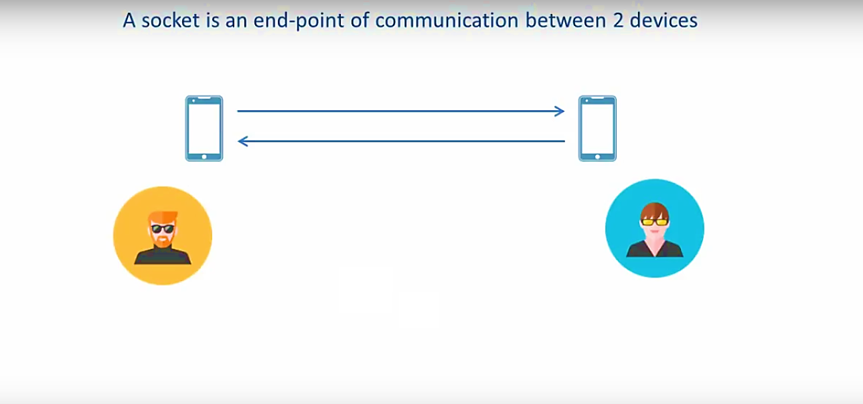
Port and Socket

Slide 9
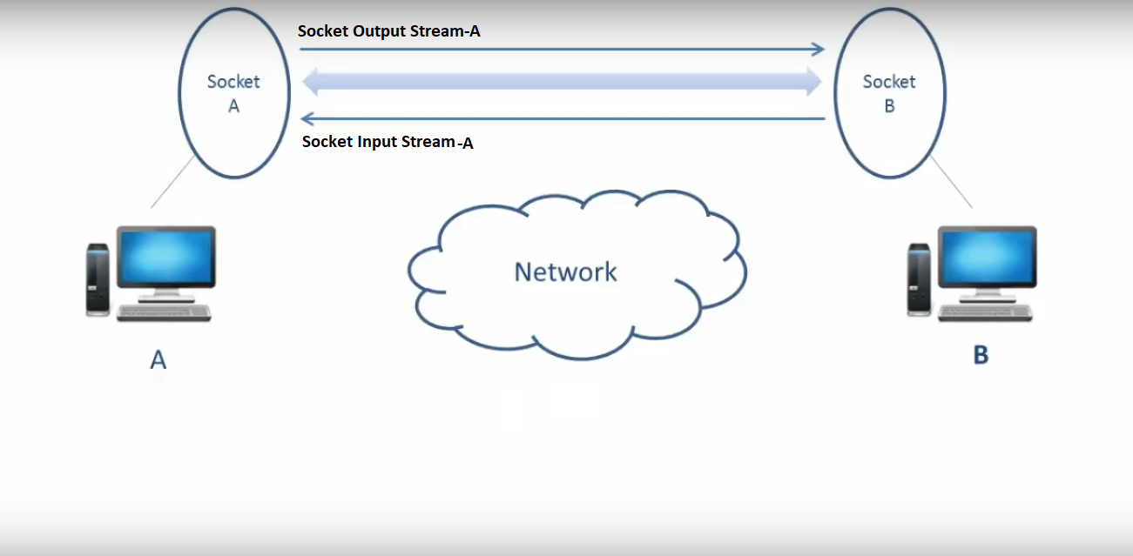
Port and Socket

Slide 10
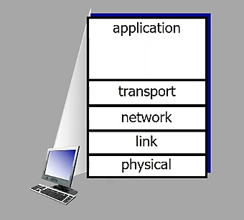
Multiplexing/demultiplexing

Slide 11
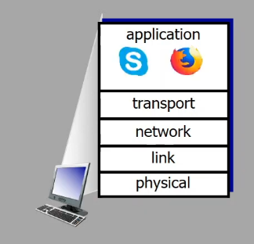
Multiplexing/demultiplexing

Slide 12
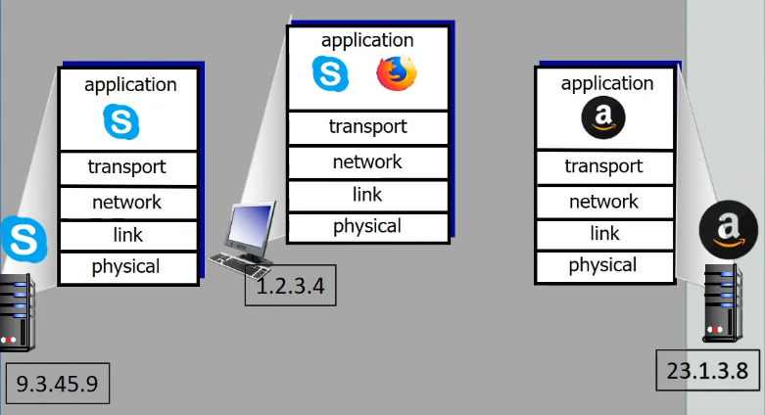
Multiplexing/demultiplexing

Slide 13
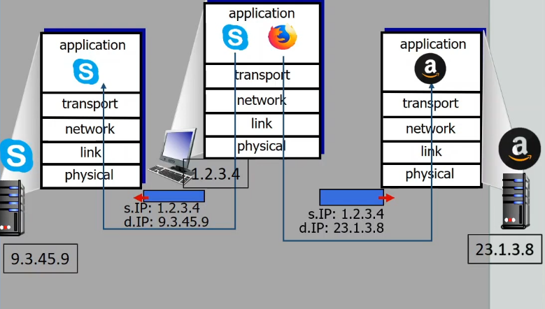
Multiplexing/demultiplexing

Slide 14
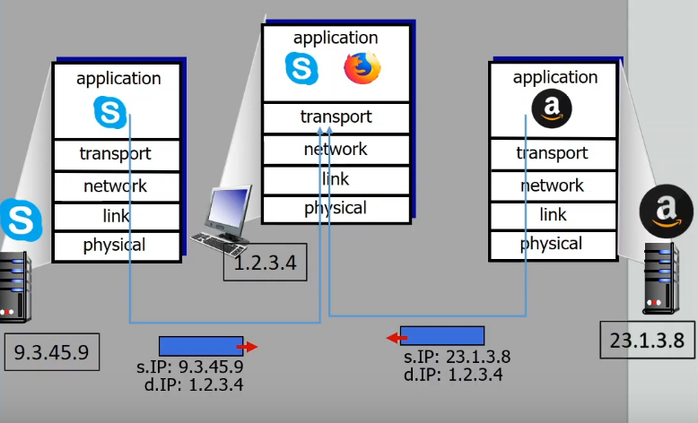
Multiplexing/demultiplexing

Slide 15
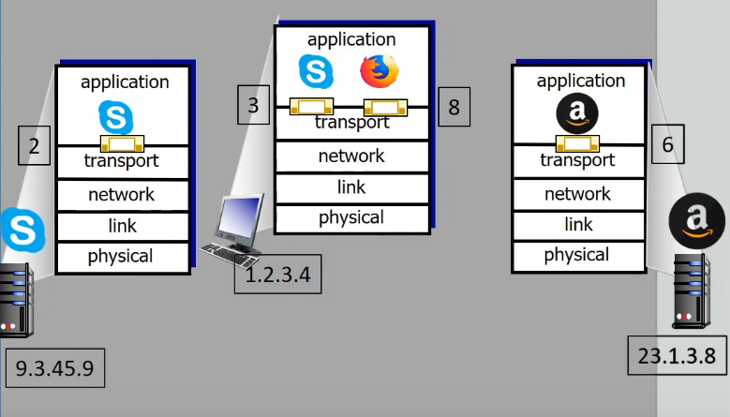
Multiplexing/demultiplexing

Slide 16
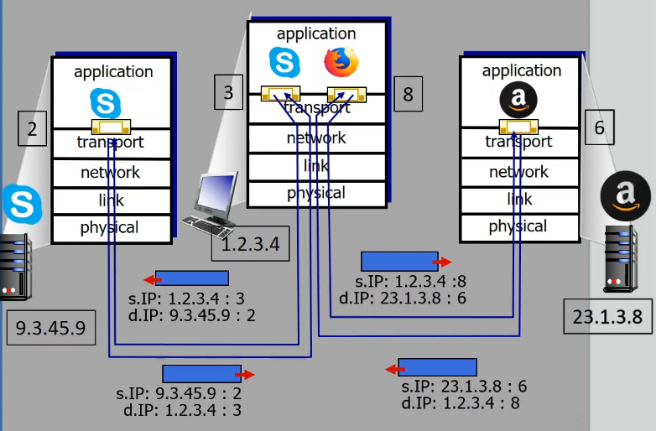
Multiplexing/demultiplexing

Slide 17
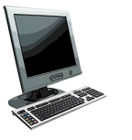
Multiplexing/demultiplexing
multiplexing at sender:
handle data from multiple
sockets, add transport header (later used for demultiplexing)
demultiplexing at receiver:
use header info to deliver
received segments to correct
socket
application
application
P1
P2
application
socket
P3
transport
P4
process
transport
network
transport
network
link
network
link
physical
link
physical
physical

Slide 18
How demultiplexing works
host receives IP datagrams
each datagram has source IP address, destination IP address
each datagram carries one transport-layer segment
each segment has source, destination port number
host uses IP addresses & port numbers to direct segment to appropriate socket
32 bits
source port #
dest port #
other header fields
application
data
(payload)
TCP/UDP segment format

Slide 19
Demux: example
Socket = 6428
Socket= 9157
Socket= 5775
application
application
P1
application
P3
P4
transport
transport
network
transport
network
link
network
link
physical
link
physical
physical
source port: 6428
dest port: 9157
source port: ?
dest port: ?
source port: 9157
dest port: 6428
source port: ?
dest port: ?

Slide 20
Demux
TCP socket identified by 4 things:
source IP address
source port number
dest IP address
dest port number
demux: receiver uses all four values to direct segment to appropriate socket
server host may support many simultaneous TCP sockets:
each socket identified by its own 4 things

